Slide 1


An Introduction to Text Analysis
Sentiment Analysis with R
@LagosRUsers
Babatunde Adebayo
(Business Intelligence Analyst)
@BT_Einstein1
https://github.com/bteinstein

Slide 2
Objectives
Understand the basic concepts in Analyzing Text Data
Understand the basic concepts and Ideas behind Sentiment Analysis
Understand the methods employed in carrying out Sentiment Analysis
Explore sentiment lexicons
Learn how to implement sentiment analysis using tidy data principles in R
Apply these skills to real-world case studies (Twitter Data)
By the end of this session, we should be able to

Slide 3


Text Data Is Everywhere
News Articles
OCR documents
Social Media
Print Media
Government Documents
Academic journals

Slide 4
Natural Language Processing (NLP)
NLP uses a variety of methodologies to decipher the ambiguities in human language, in tasks like:
Automatic summarization
Sentiment analysis
Part-of-Speech (POS) tagging
Disambiguation
Entity extraction
Natural language understanding and recognition.
Natural language processing (or NLP) is a component of text mining that performs a special kind of linguistic analysis that essentially helps a machine “read” text.

Slide 5

Sentiment Analysis
Some application domain
Ecommerce
Healthcare
Political Science
Survey responses Analytics
Monitoring and Evaluation
Social media monitoring
Brand monitoring
Voice of customer (VoC)
Customer service optimization
Market research
Aviation
Sentiment analysis (also known as opinion mining or emotion AI) refers to the use of NLP, text analysis, computational linguistics, and biometrics to systematically identify, extract, quantify, and study affective states and subjective information.

Slide 6
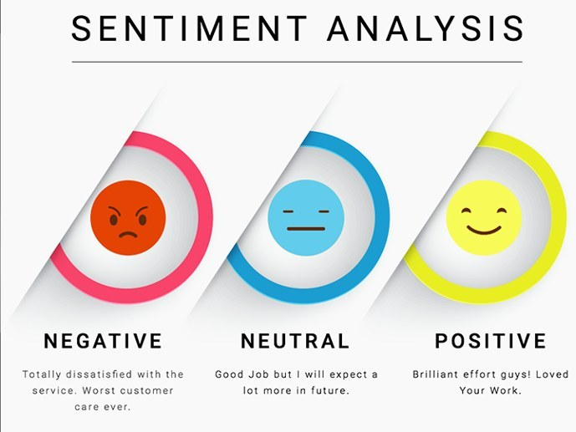
?

Slide 7
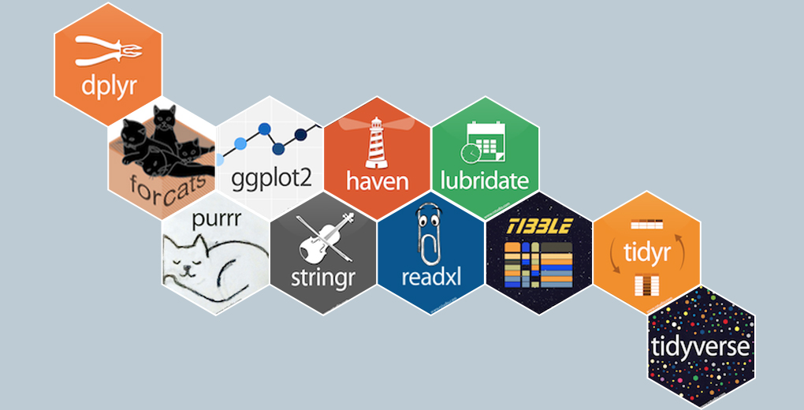
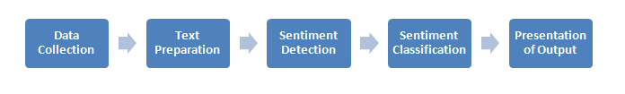
Workflow

Slide 8
Methods
Supervised
Unsupervised/Rule-based Approaches (e.g. Lexicon Based)
Hybrid (Combination of Supervised and Unsupervised)
Analysis can be on:
Document-level
Sentence-level Aspect based – different perspective to same entity (e.g. product review)

Slide 9
Unsupervised Approach (Lexicon)
Define two lists of polarized words called Lexicons
negative words: bad, worst, ugly, etc.
positive words: good, best, awesome, beautiful, etc.
Given a text:
Count the number of positive words that appear in the text.
Count the number of negative words that appear in the text.
Define the Rule: assign
Positive: If the #(positive words) > #(negative words)
Negative: If the #(positive words) < #(negative words)
Otherwise, return Neutral
Analyze the result

Slide 10

Sentiment Lexicon in R
General purpose lexicons from tidytext package:
AFINN: assigns words with a score that runs between -5 and 5, with negative scores indicating negative sentiment and positive scores indicating positive sentiment
Bing: assigns words into positive and negative categories
NRC: assigns words into one or more of the following ten categories: positive, negative, anger, anticipation, disgust, fear, joy, sadness, surprise, and trust

Slide 11
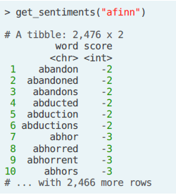
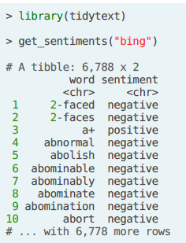
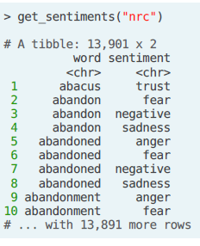
tidytext::get_sentiment()

Slide 12


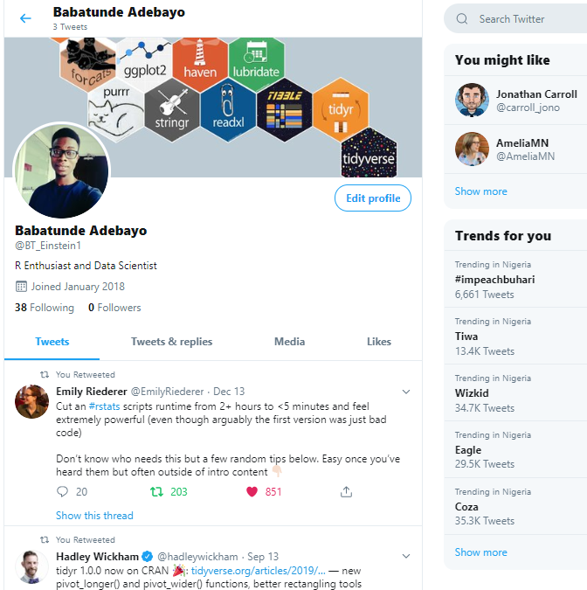

Data
We will be using Twitter data via the rtweet package

Slide 13
Preprocessing – Tidy Text
Tidy Data principle state that:
Each variable is a column
Each observation is a row
Each type of observational unit is a table
“Tidy text format is defined as a table with one-token-per-row.
Where a token is a meaningful unit of text, such as a word, that we are interested in using for analysis, and tokenization is the process of splitting text into tokens.

Slide 14
Preprocessing
Involve various techniques aim at cleaning the text data (for any task at hand).
These techniques are applied to reduce the noise in the text, reduce dimensionality, and assist in the improvement of models' effectiveness
Some of the frequently used techniques include:
Tokenization | Remove punctuation
Remove numbers | Remove stopwords
Stemming | Part of speech tagging
Normalization -Lowercase

Slide 15

Hands-on
R
🏃

Slide 16
Questions?

Slide 17
THANKS!

Slide 18
Resources
Sentiment analysis with tidy data
Tidy Sentiment Analysis in R
Slide Design – Unsplash
Sentiment Analysis Methodology

